Slide 2


Our Team
Data Scientist
Senior Data Analyst
< >
< >
Karlo
Leo Karlo dela Cruz
Adam
Adam Christian P. Amistad

Slide 3


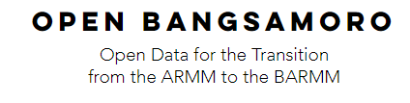

Insights at a Glance
An Entry for Bangsamoro Data Challenge

Slide 4
Outline
Problem Statement
Proposal
Datasets Used
Notes:
Notes:
I’d talk to you about –
Assignment:
(insert pagoda pictures in the airport)

Slide 5

Problem Statement
Currently, there’s no organized means for Decision Makers to inspect relevant information regarding the development challenges of BARMM.
Data are in different formats, which makes it difficult to extract insights.
Analysis/ Solution/
Recommendation
Data
Notes:
There should be a tool that will provide an organized view of relevant information regarding the current development challenges of BARMM, which will guide Decision Makers to implement the right solutions.

Slide 6
Outline
Problem Statement
Proposal
Datasets Used

Slide 7

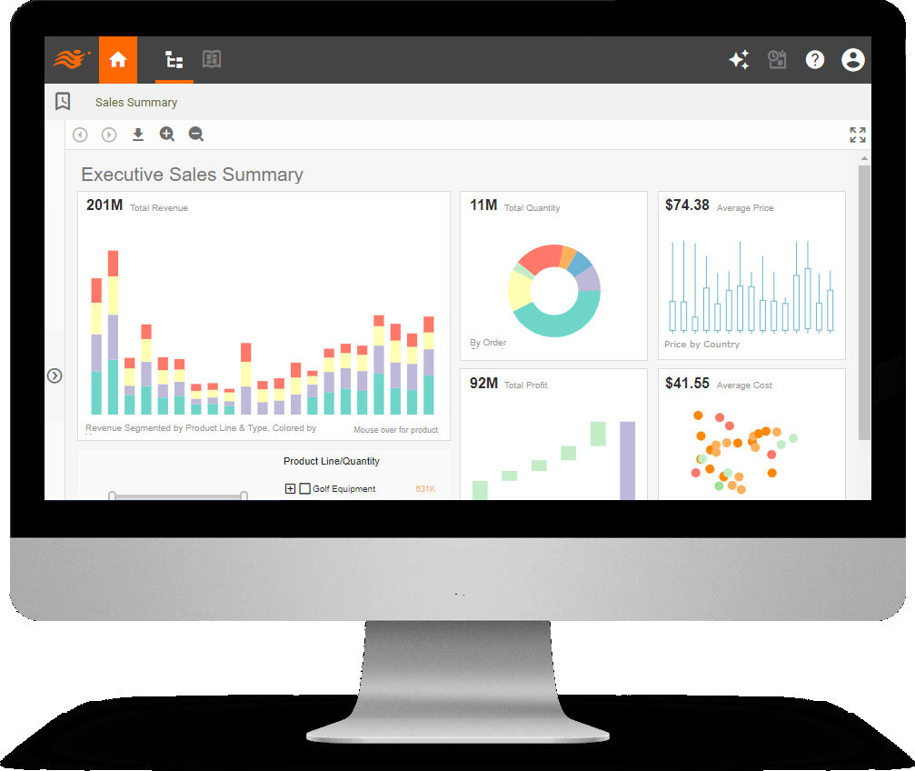
Proposal
Our proposal is a collection of dashboards that aim to provide exploratory and analytical capabilities as well as a geospatial reference for Decision Makers to gain insights regarding specific development challenges.

Slide 8
Dashboards
Social
Governance
Economic
Environmental

Slide 9
Outline
Problem Statement
Proposal
Datasets Used

Slide 10
Datasets Used
Social
Governance
Economic
Environmental
Gainful workers 15 years old and over and their major occupation by sex
SchoolsARMMDEPED2017
Population 2010, 2015 ARMM and BCT
SGLG Awarded Municipalities
https://www.dilg.gov.ph/PDF_File/reports_resources/dilg-reports-resources-2018125_ddbe4d4754.pdf
https://www.dilg.gov.ph/PDF_File/reports_resources/dilg-reports-resources-2018101_0cf6f6f1dc.pdf
Bangsamoro Provincial Boundaries ao 20190206
Number of DTI Registered Firms per Municipality, 2013
Location of Banks, 2018
Location of Operational ARMM RBOI Registered Firms from 1992 to 2018
Bangsamoro Provincial Boundaries ao 20190206
5 – New Maps > 08 – Hazards > Flood > Images
5 – New Maps > 08 – Hazards > Landslides > Images

Slide 11
Demonstration

Slide 12
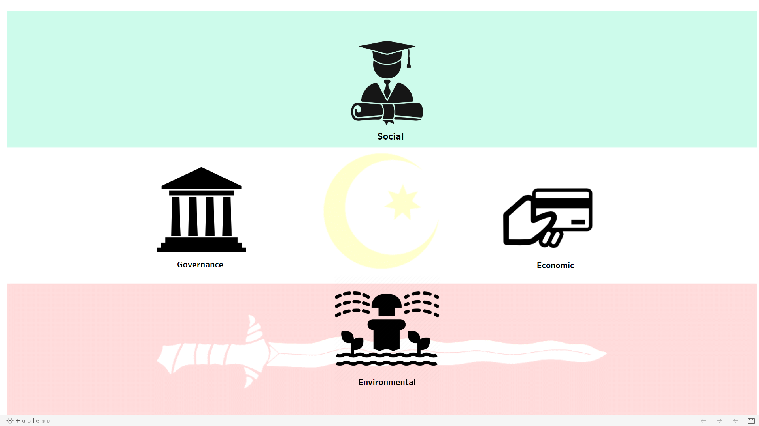
Main Menu
Notes:
https://public.tableau.com/views/BANGSAMOROPORTAL/Dashboard1?:display_count=y&publish=yes&:origin=viz_share_link

Slide 13

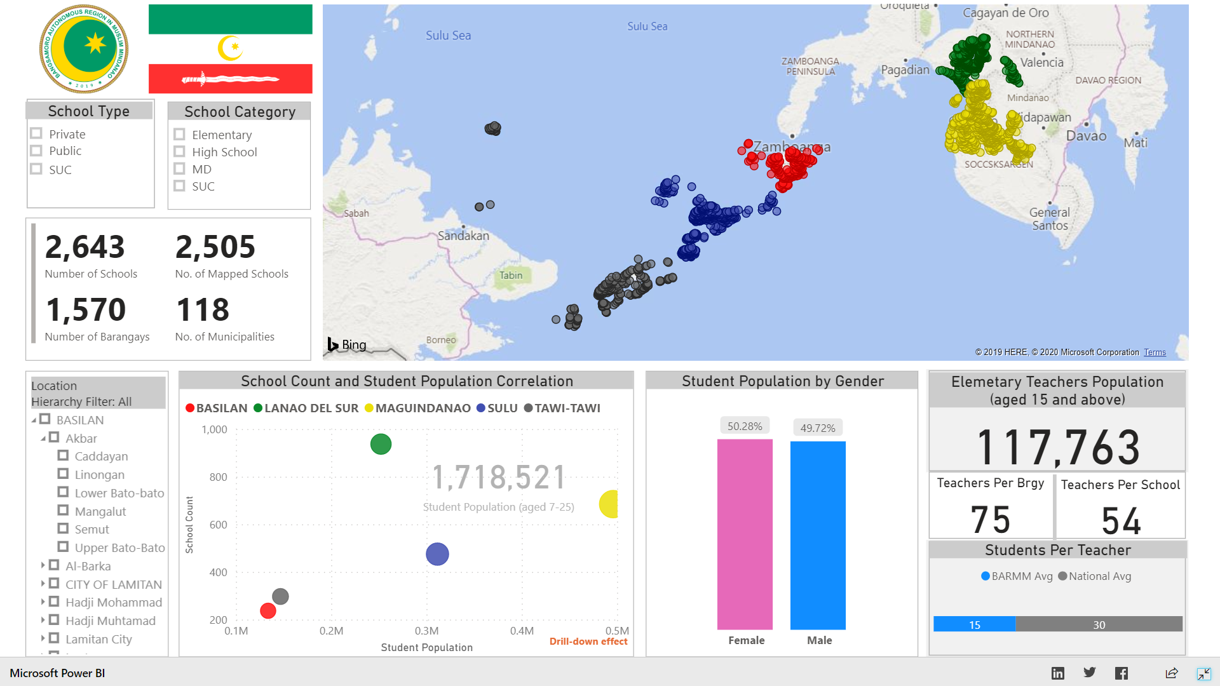
Social

Slide 14

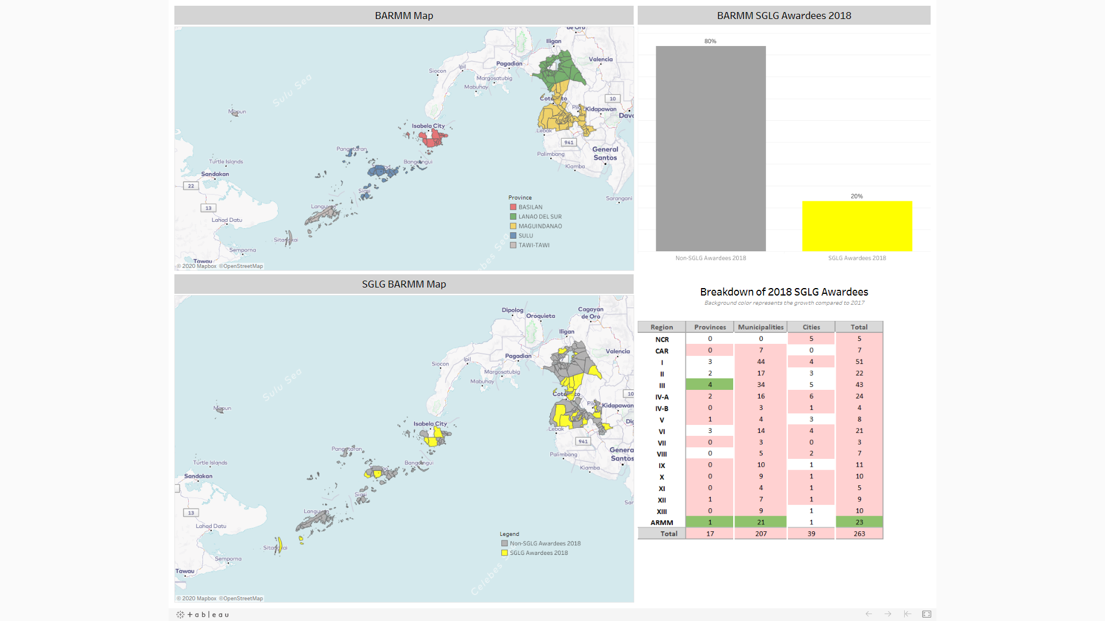
Governance

Slide 15

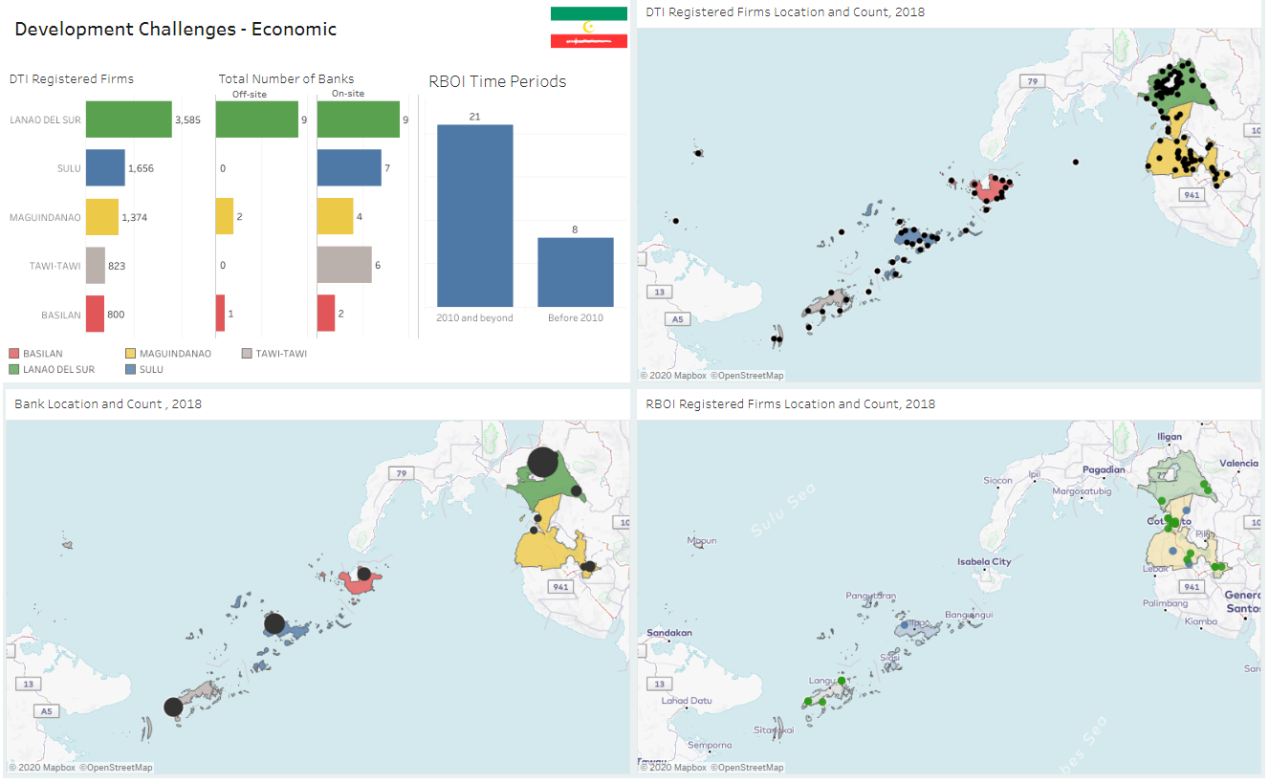
Economic

Slide 16

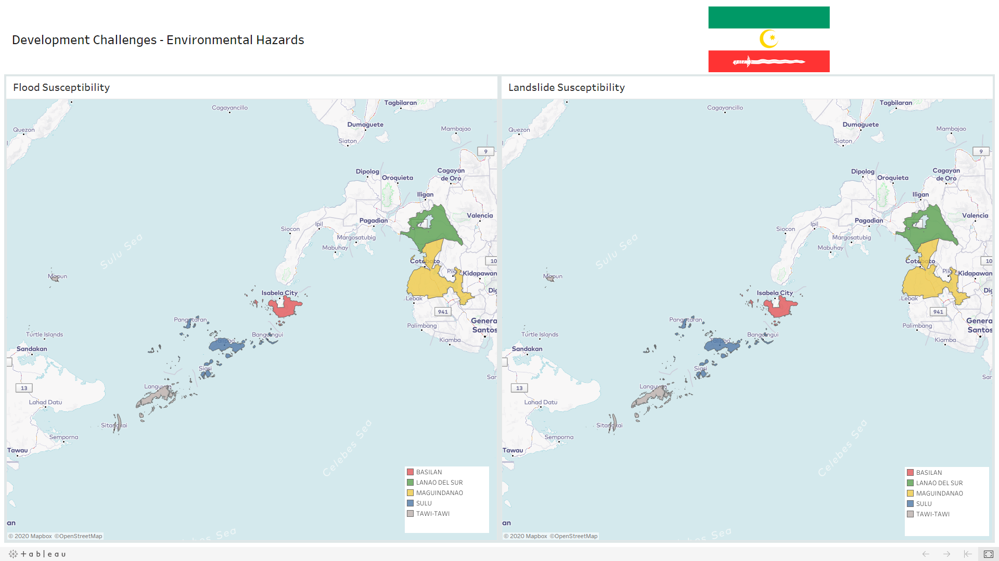
Environmental

Slide 17
Thank you for listening!
END

